Slide 1


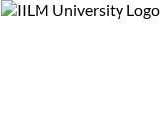

IILM UNIVERSITY, GREATER NOIDA, U.P.
School of Computer Science and Engineering
INTERNSHIP REPORT PRESENTATION
Ambrosia
A B2B Canteen & Food Ordering Platform for Industrial Workforces
Submitted by
Programme
RAGHVENDRA KUMAR
B.Tech CSE-core
Roll Number: 25SCS1003003959
Batch: 2025-2029 | 2026-27

Slide 2

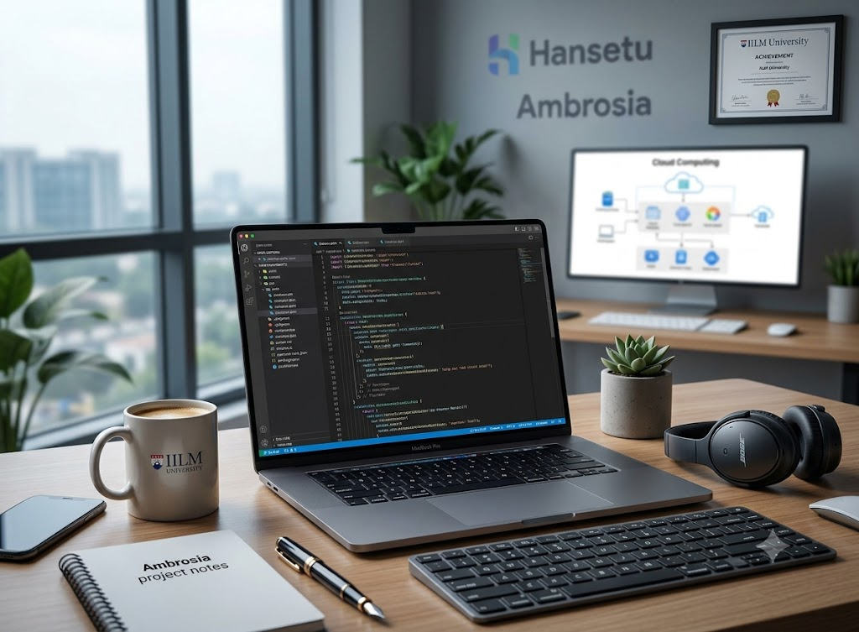

About the Student
Candidate Name Raghvendra Kumar
Roll Number 25SCS1003003959
Programme B.Tech CSE (Batch 2025-2029)
Internship Role Developer Team Member
Duration 26/05/2026 to 25/07/2026

Slide 3







Organization Profile
The Company
Nature of Business
My Role
Lobra Hansetu Private Limited (Hansetu)
Located in Karnal, Haryana, the company focuses on digital transformation and innovative B2B solutions.
B2B Platforms
Specializing in the development of comprehensive B2B industrial platforms and mobile applications tailored for business clients.
Developer Team Member
Responsible for front-end implementation in Flutter, system support, and team coordination to build platform functionalities.

Slide 4


The Problem Statement
Manual Inefficiencies
Industrial units and factory campuses typically manage staff canteen operations manually using paper tokens and verbal orders.
Operational Bottlenecks
This outdated approach leads to long queues, order errors, and a complete lack of visibility into daily demand for the vendor team.
The Need
As part of Hansetu's B2B offerings, there was a pressing need for a lightweight, digitized ordering module for industrial workforces without adding unnecessary complexity.

Slide 5
Project Objectives (Ambrosia)
Cross-Platform Design Design and develop the Ambrosia B2B canteen ordering application using Flutter for cross-platform compatibility.
Real-Time Backend Integrate a real-time backend using Firebase for secure user authentication and seamless data management.
Complete Ordering Flow Implement a comprehensive user journey for industrial staff: browsing menus, managing the cart, and placing orders.
Vendor Visibility Provide the canteen/vendor side with real-time tracking of incoming orders through the unified Firebase backend.

Slide 6



Technologies & Tools Used
Frontend Framework
Backend Services
Tools & Integrations
Flutter (Dart)
Utilized to build a responsive, single-codebase client application that runs smoothly on both Android and iOS devices.
Firebase Ecosystem
Firebase Authentication, Cloud Firestore, and Storage powered the serverless, real-time database and user management.
Version Control & APIs
Git & GitHub for version control, with planned future integrations for Google Places API and Razorpay Payment Gateway.

Slide 7


System Architecture
Client-Backend Architecture
Ambrosia follows a streamlined serverless architecture tailored for B2B industrial deployments.
•
Client Layer: Flutter application handles UI and interactions for industrial employees.
•
Authentication: Firebase Auth secures user sign-in processes.
•
Data Layer: Cloud Firestore stores menu items and order details, instantly notifying staff of new orders.
•
Storage: Firebase Storage manages image assets like menu photos.
Direct client-to-Firebase communication eliminates the need for a custom backend server.

Slide 8




Development Methodology
2. UI/UX & Flutter Dev
4. Testing & Release
Designing user flows and building core screens (browse, cart, checkout) in Flutter.
Verifying the ordering flow end-to-end and preparing the release APK for GitHub.
1. Requirement Analysis
3. Firebase Integration
Identifying core features for the Ambrosia B2B canteen ordering module.
Setting up auth, Firestore collections, and storage for real-time data sync.

Slide 9



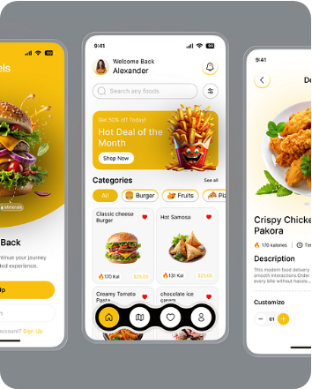
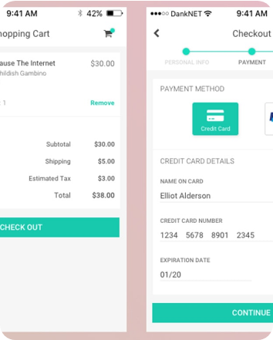
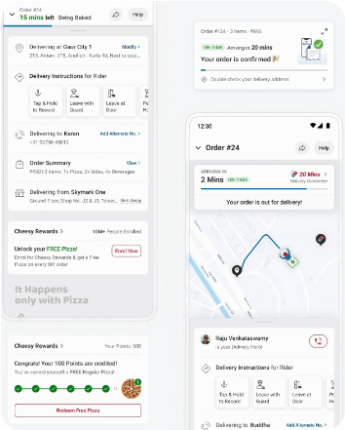
Ambrosia Application Screens
Browsing Canteen Menu
Order Summary & Cart
Real-Time Order Tracking

Slide 10
Expected Outcomes & Learnings
Functional Deployment Delivered Ambrosia, a fully working B2B canteen ordering mobile application with a complete, user-friendly ordering flow.
Technical Proficiency Gained extensive hands-on experience using Flutter for cross-platform mobile development (Android & iOS).
Backend Mastery Developed a practical understanding of integrating a scalable, serverless backend (Firebase) directly into a mobile environment.
Production Delivery Successfully prepared a release-ready APK build, published to GitHub, ready for deployment across industrial client sites.

Slide 11

Thank You
I am open to any questions or feedback regarding the Ambrosia project.
Raghvendra Kumar

